Slide 1


REACT.JS
LUIGI RAUSO
fs 16 - TEACHER Assistant

Slide 2










introduction to react.js
React is a famous JavaScript library created by Facebook and is now widely used in web development for building user interfaces.
It is component-based, with each component being a reusable UI element, making code updates easier.
It utilizes a declarative approach, which simplifies the coding process.

Slide 3
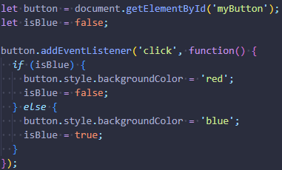
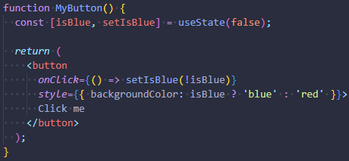
KEY FEATURES OF REACT
Imperative Approach (Non-React):
JSX (JavaScript Syntax Extension): a combination of HTML and JavaScript.
Virtual DOM: An exact copy of the real DOM that updates only the parts that have changed, this results in a boost of performances.
One-way Data Binding: data flows from parent components to child components.
Extensions: React has many extensions for creating comprehensive UI applications.
Declarative Approach (React):

Slide 4
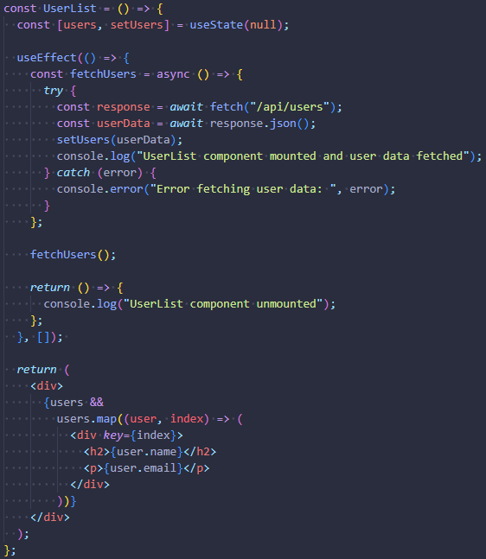
main REACT HOOKS
How to use useState and useEffect:
useState: this hook lets you add state to functional components. It returns a pair: the current state value and a function that lets you update it.
useEffect: this hook lets you perform side effects in functional components. It executes side effects, such as data fetching or updating the DOM, after the component’s initial render and whenever its specified dependencies change. It also provides a cleanup function which runs when the component unmounts.

Slide 5
PRACTICE IS THE KEY!
EXERCISE:
TIPS:
Create a React component that fetches data from this API: https://jsonplaceholder.typicode.com/posts
The component should not display all posts at once. Instead, implement a feature that allows displaying 10 posts at time each time a button is clicked. When all posts have been displayed, the button should become disabled.
Use the slice method to progressively display the posts.
Use the map function to render each post.

Slide 6

html, css,
Vanilla javascript
react.js
BEST OF LUCK!

